Slide 1
Virtual network in azure

Slide 2
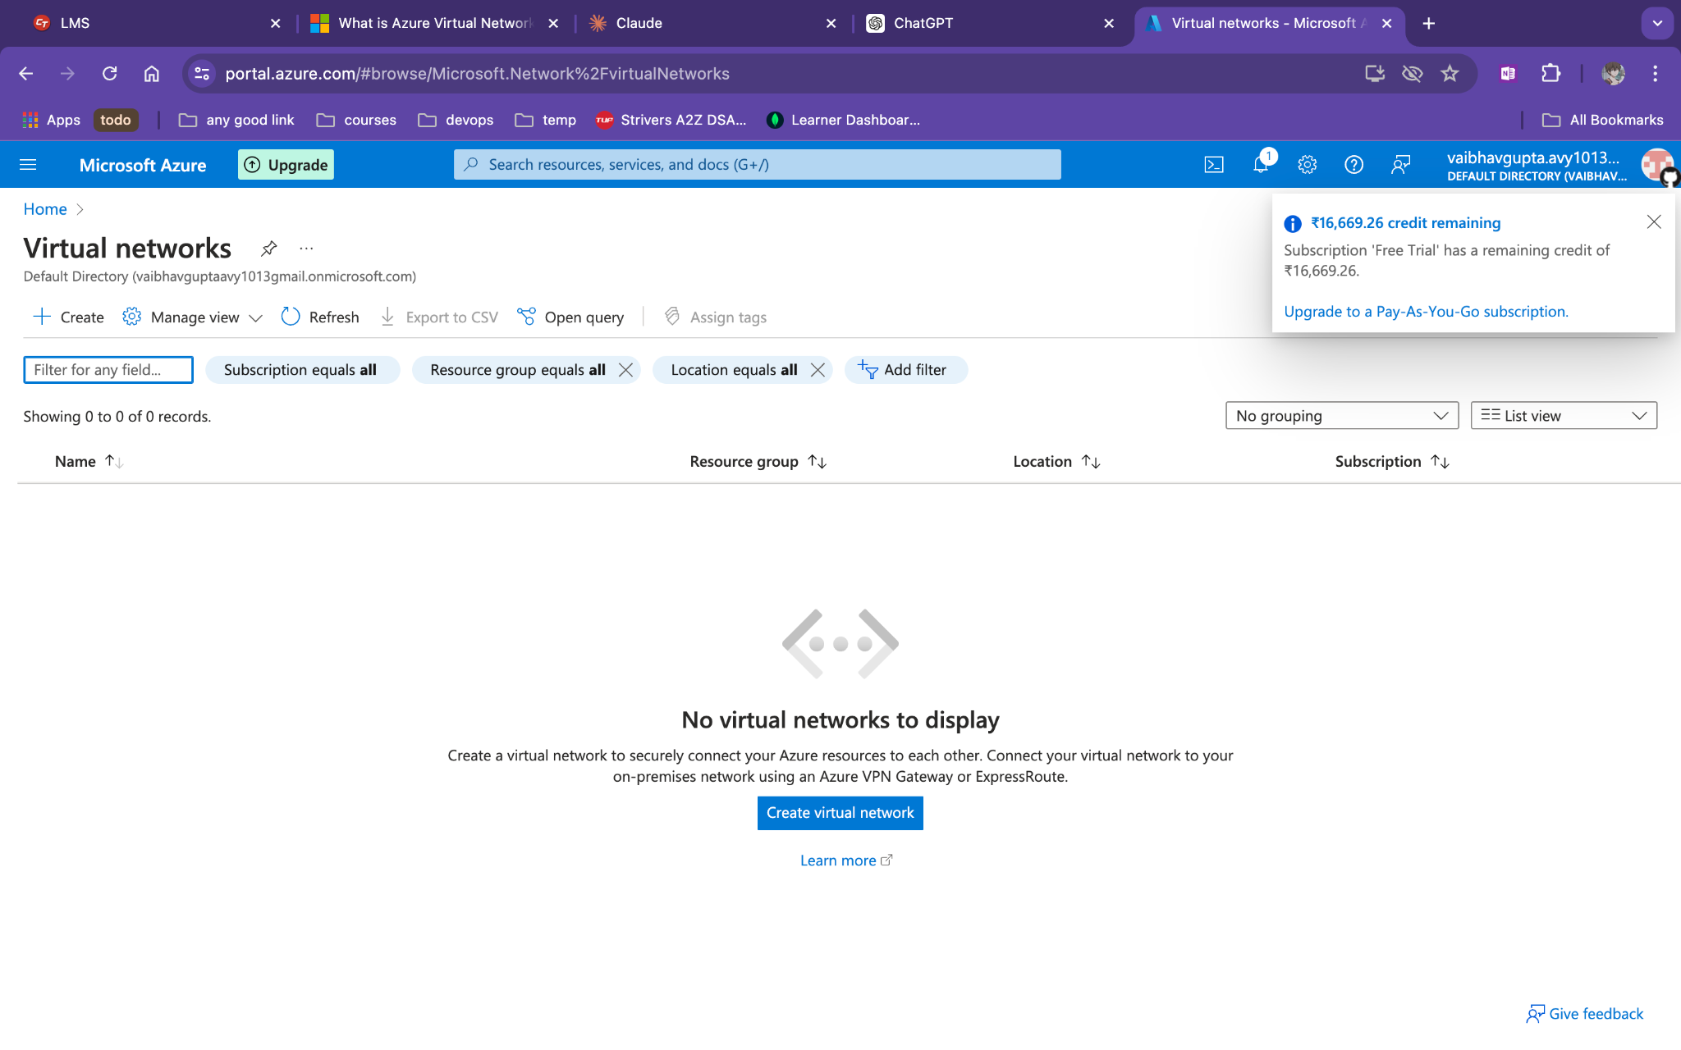
Create a virtual machine

Slide 3
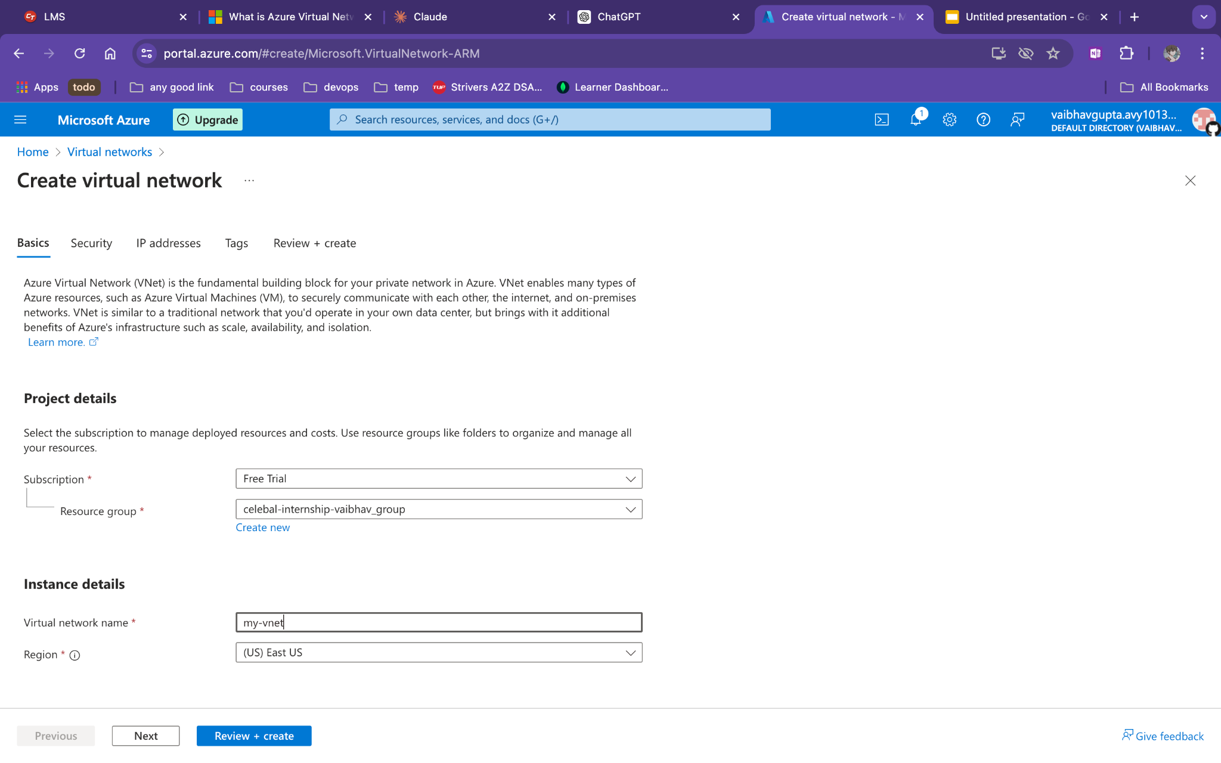
Add name of vnet

Slide 4
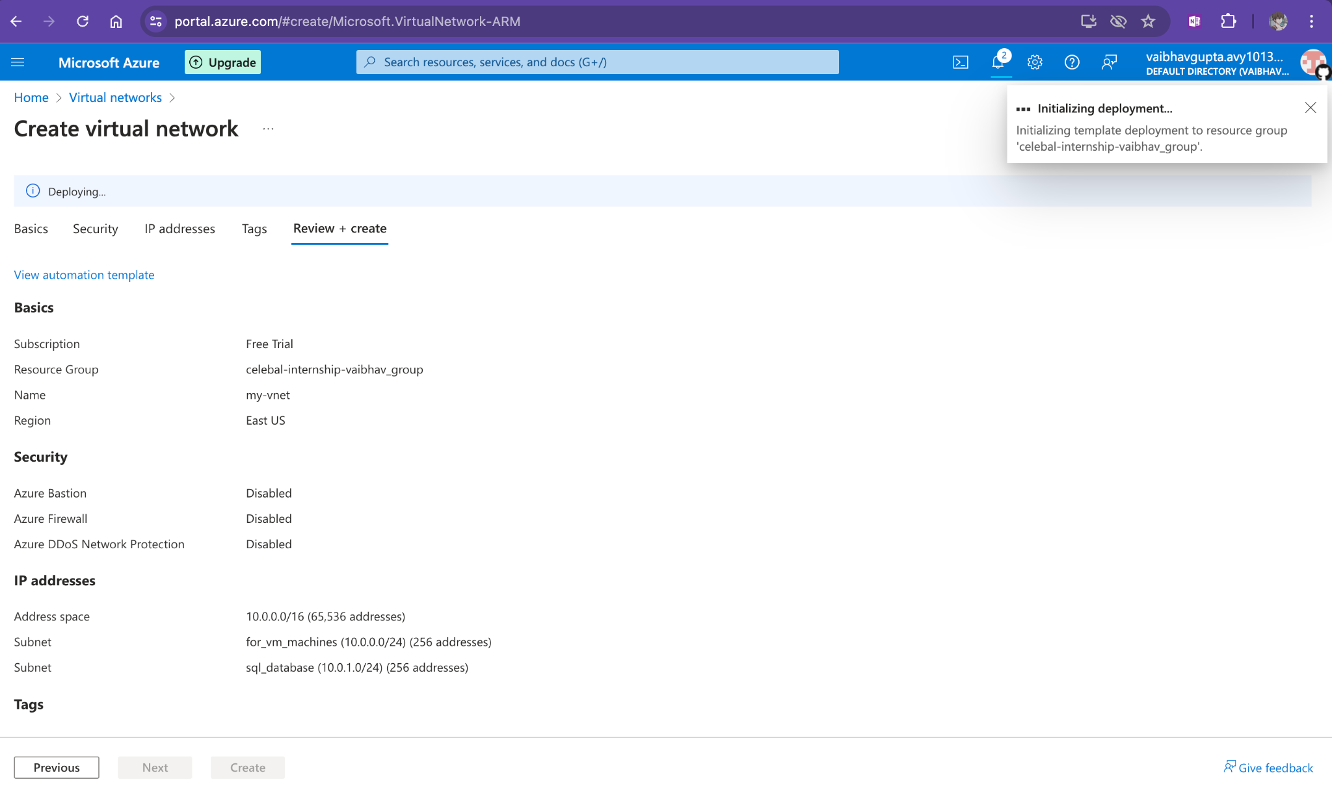
After adding a subnet
Create it

Slide 5
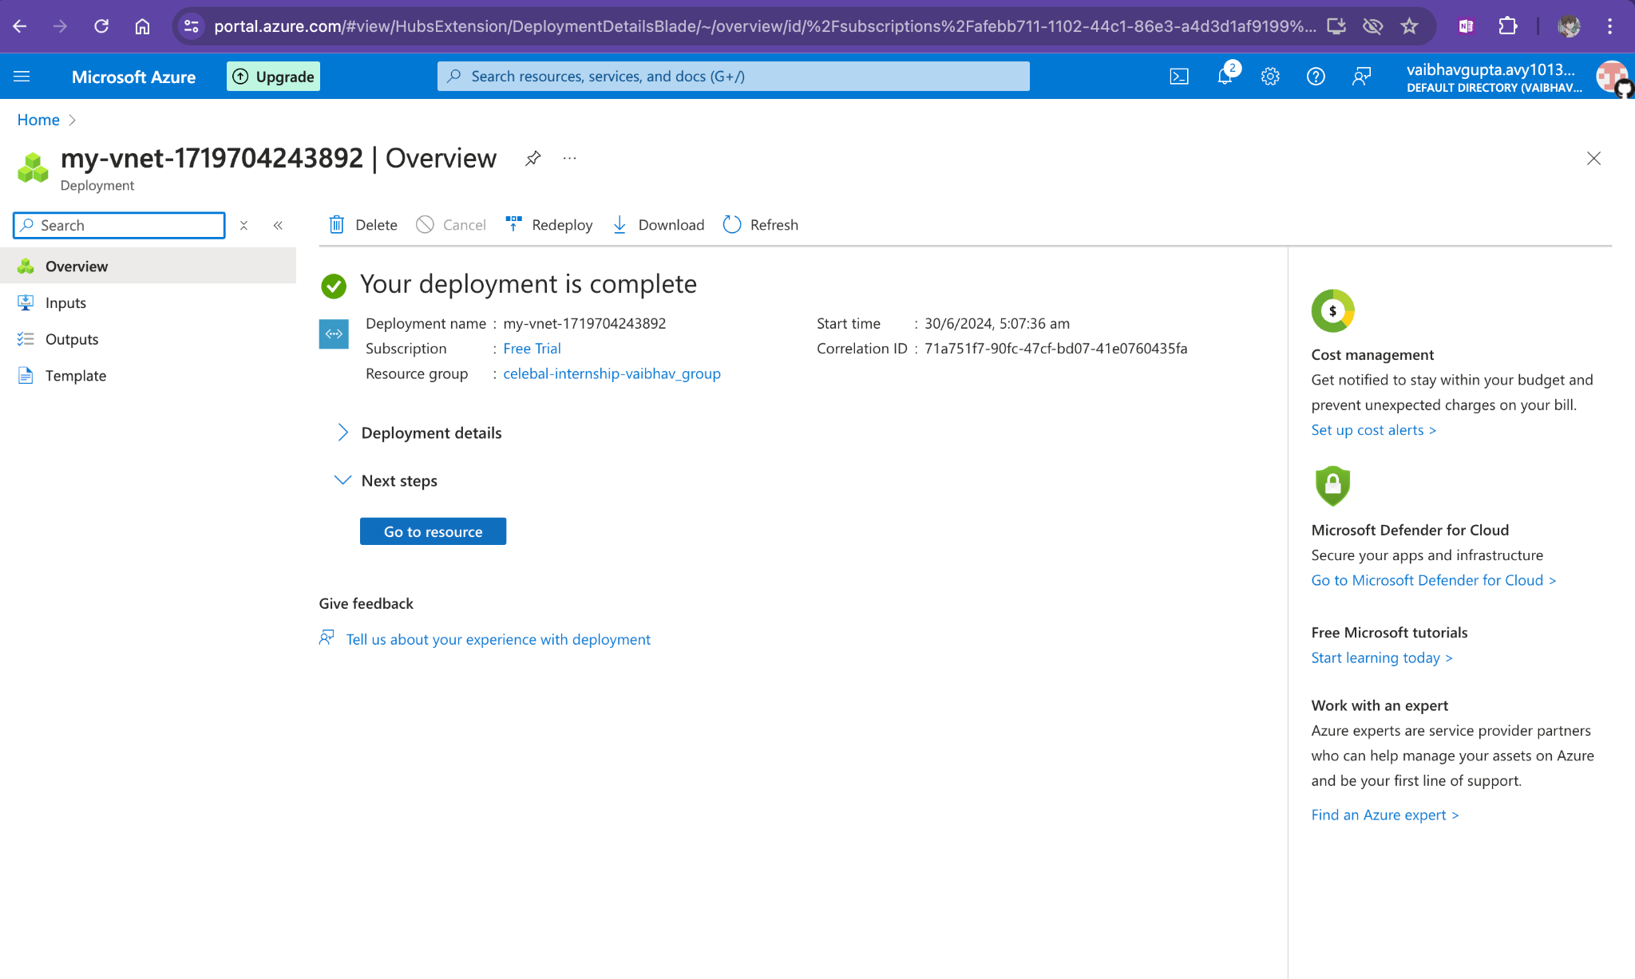

Slide 6
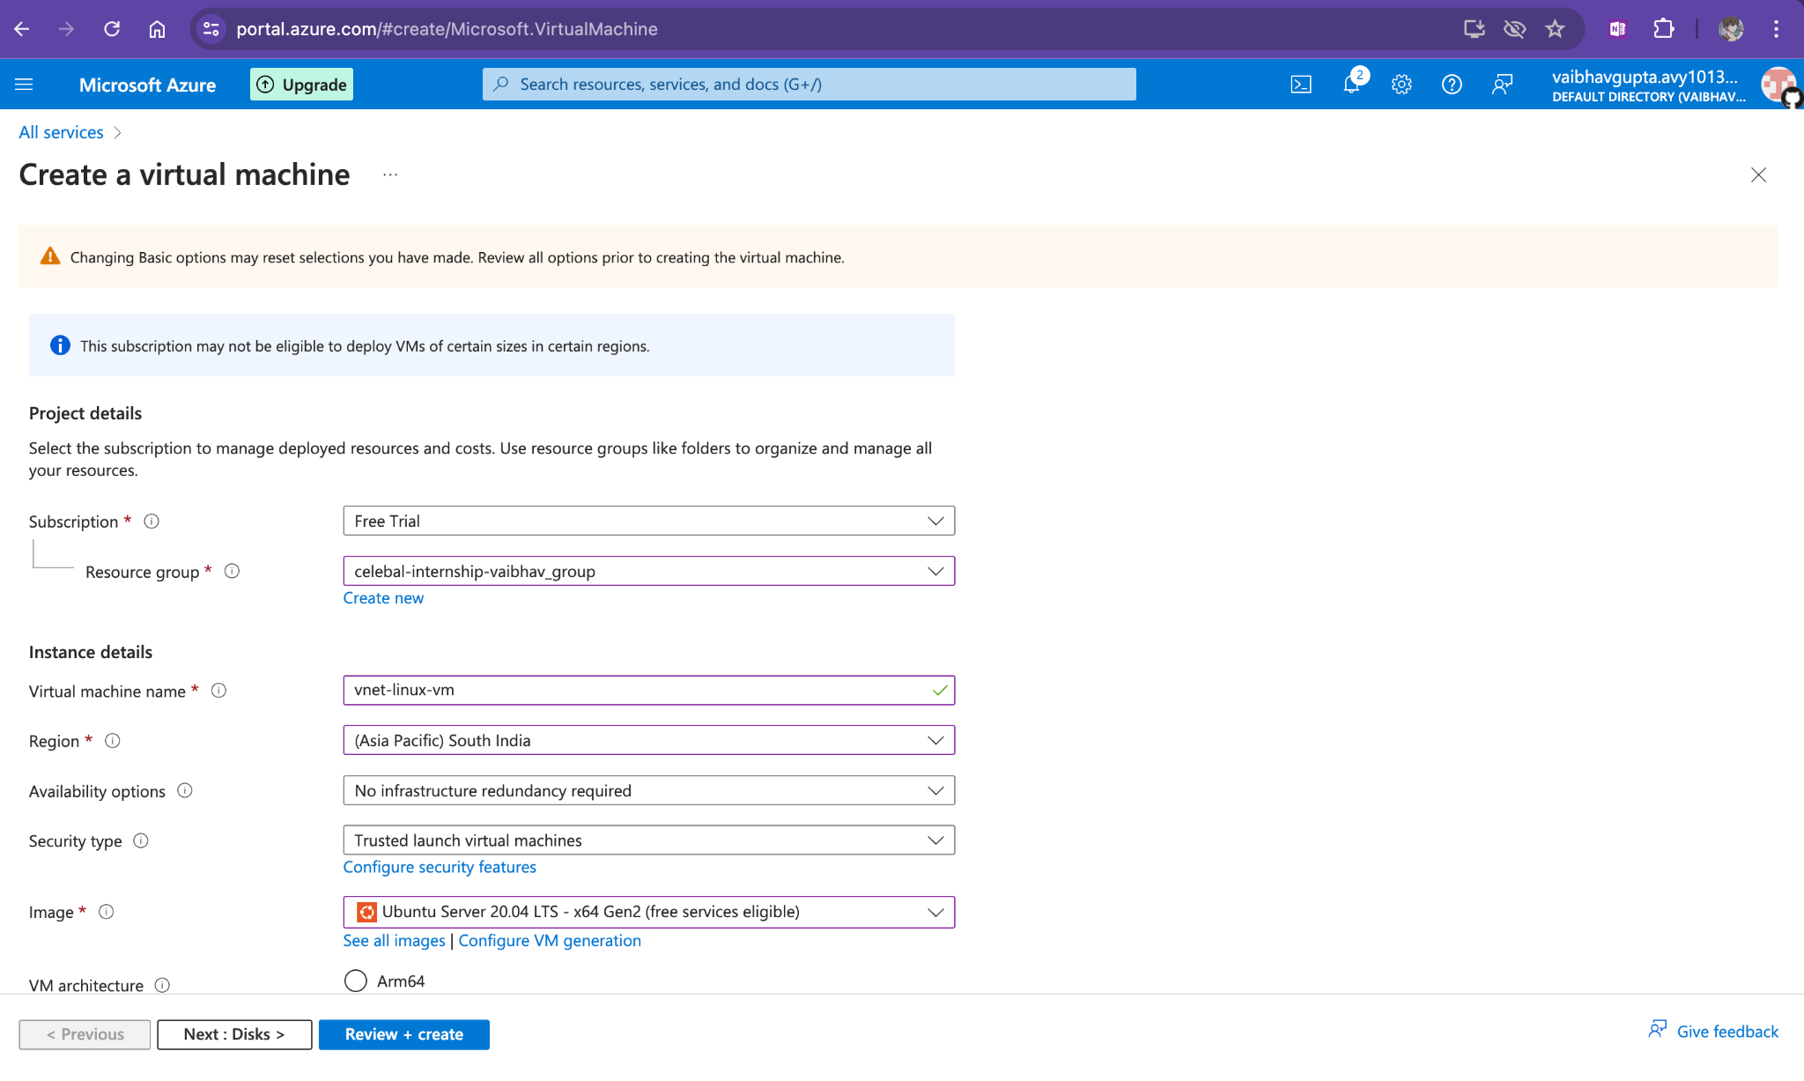
Create it in the same region

Slide 7
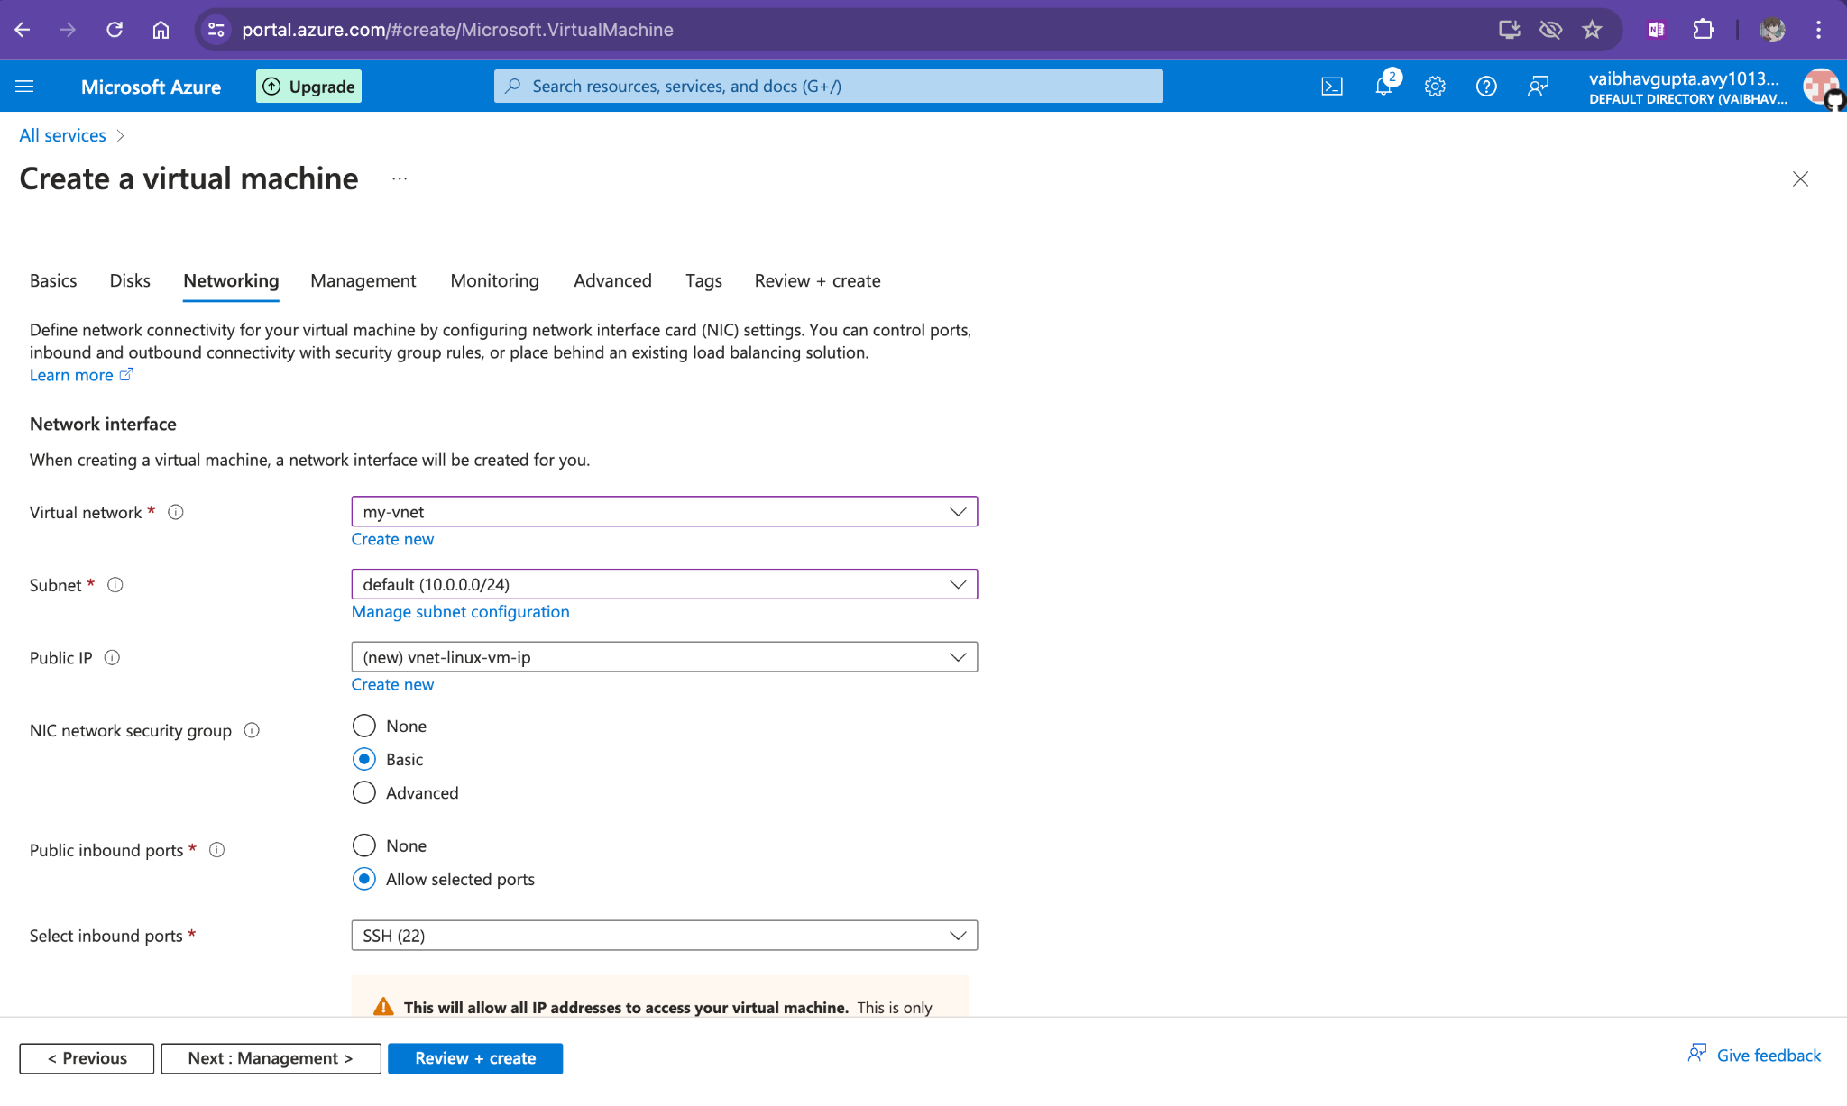
Add custom vnet in networking

Slide 8

Do same for windows...

Slide 9
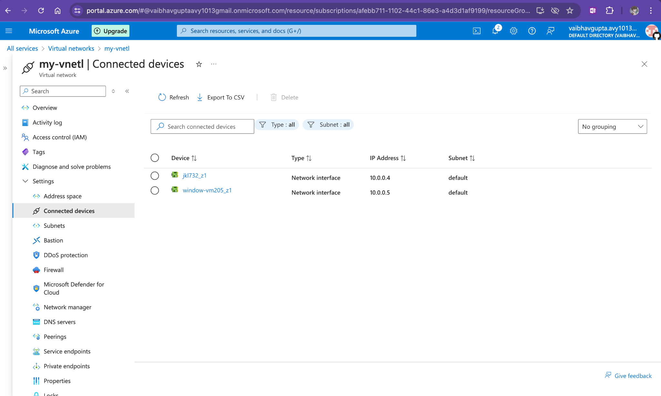
Two vm in one subnet

Slide 10
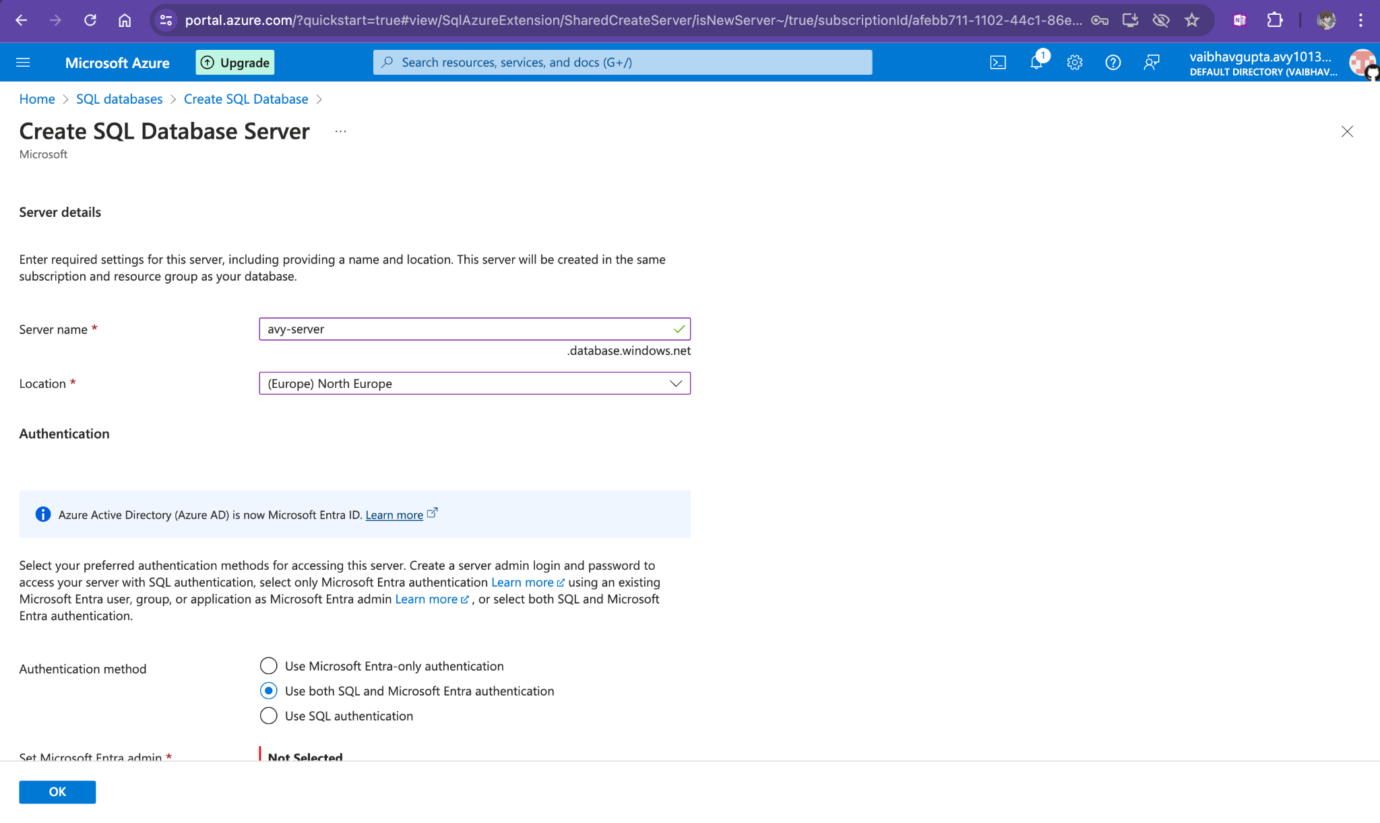
Create a sql server

Slide 11
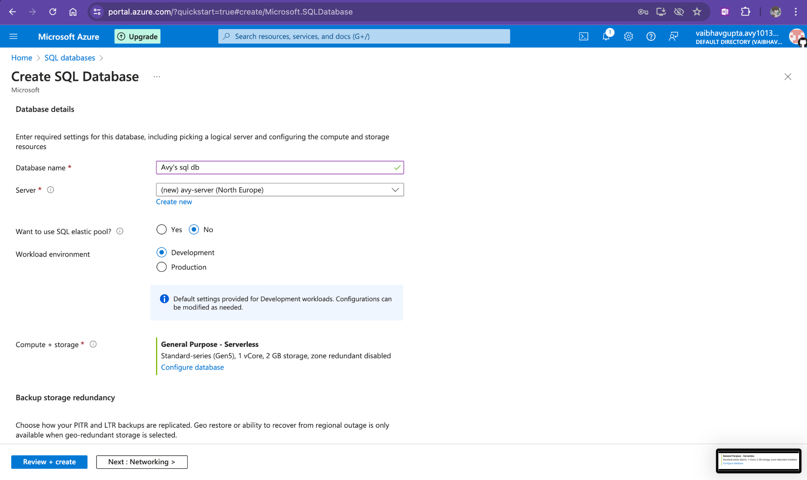
Create a sql db

Slide 12
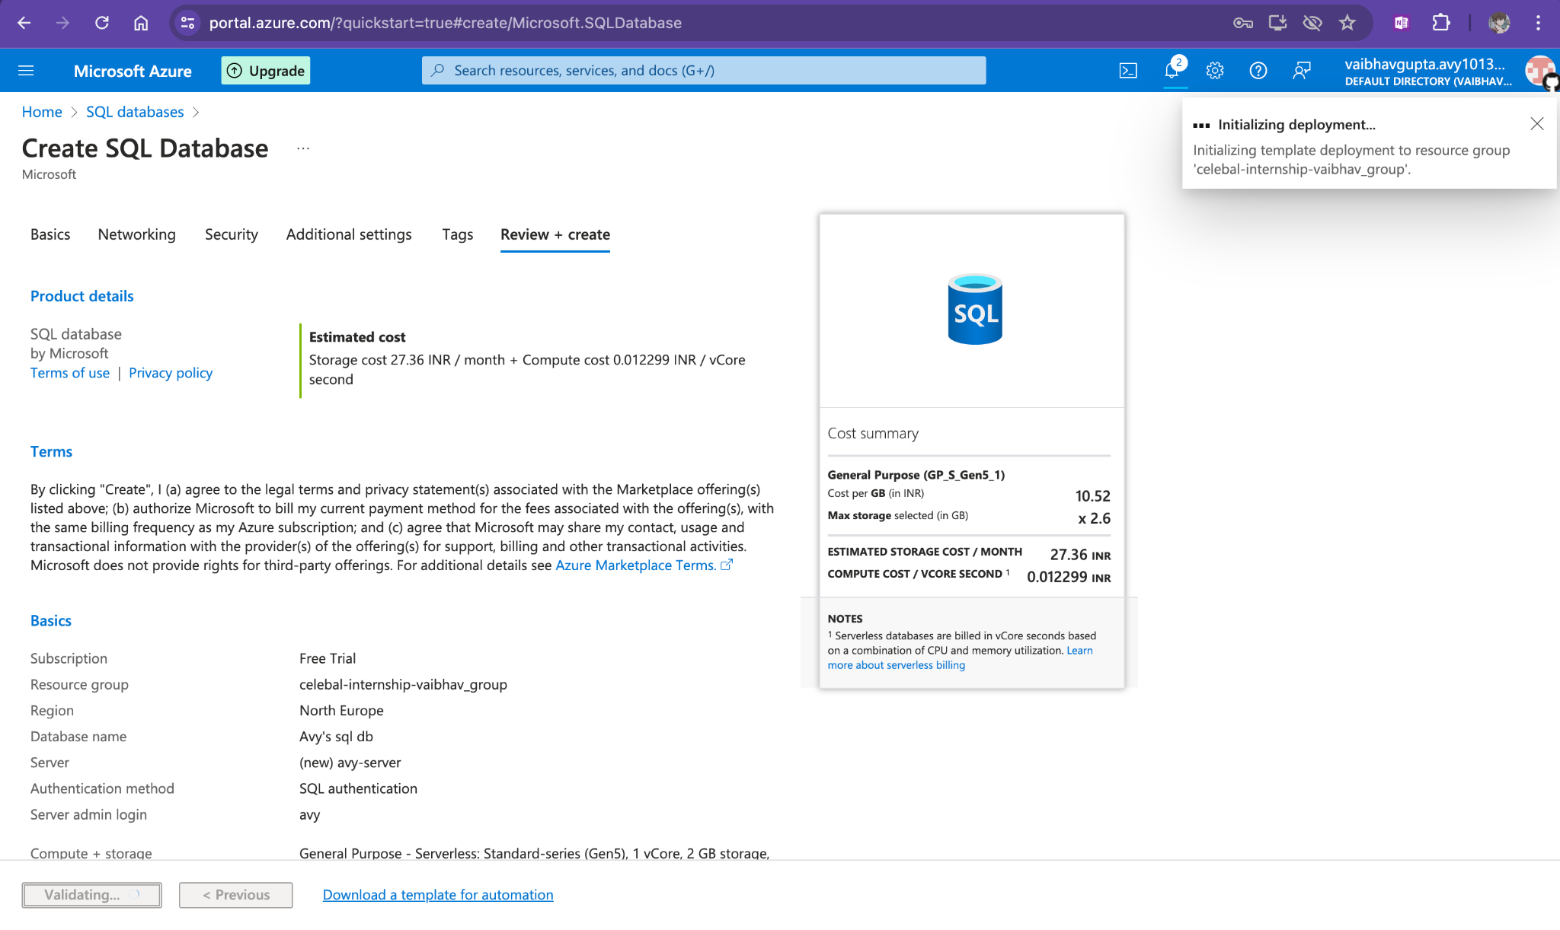
Final setup

Slide 13
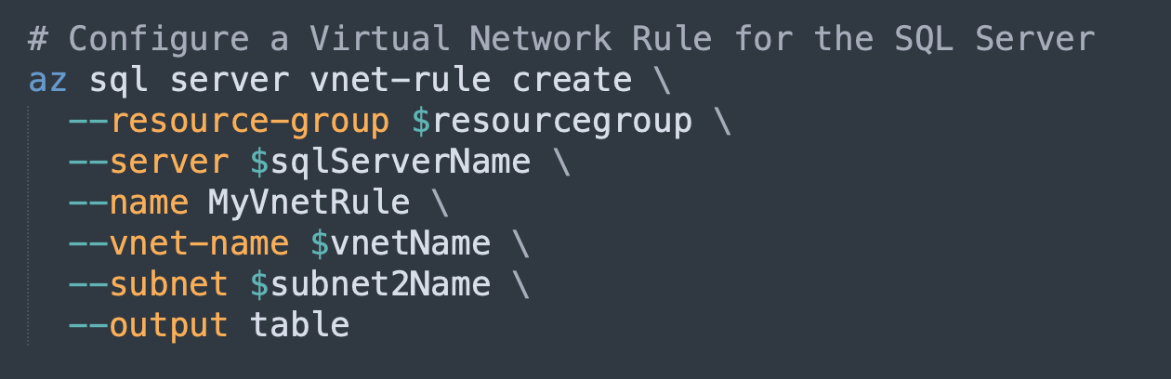
Edit the sql server for subnet 2
And your done

Slide 14
Did many things here
Created two virtual machine
Created a db
Connected the vms to subnet 1
Connected the sql server to subnet 2
Hooray !! end of job
Also in git there is the cli file for doing it in a instant

